Slide 1
AESTHETIC ANALYSIS

Slide 2
TEAM MEMBERS:
ANUSUYA G –19IT06
MANOJ N –19IT30
RANJITH B –19IT41
SAKTHI SUDHARSINI S –19IT43
MENTOR AND DESIGNATION:
DR.HEMALATHA B -- AP/IT

Slide 3
CONTENT:
INTRODUCTION
ABSTRACT
WORKFLOW
LITERATURE REVIEW
OBJECTIVE
MODULES
TIME LINE CHART

Slide 4
INTRODUCTION:
AESTHETIC ANALYSIS :
Aesthetic analysis is a careful investigation , Aesthetic means the pleasant , positive or artful appearance of person or a thing and events that evoke an Aesthetic response.
Aesthetic analysis app is used to control mood induction enables us to know better, to understand and manage our emotions.
Effort has been made in emotion research to create a system that artificially elicit emotional changes.
Numerous mood induction procedures have been developed to generate positive , negative and neutral mood states.

Slide 5
Abstract:
Emotions are a big part of human communication.
Most of the communication takes place through emotion.
The main aim of our project is to develop a robust system which can detect as well as recognize human emotion from live using face detection .
There are some emotions which are universal to all human beings like HAPPY, SAD, SUPRISE, FEAR, LOVE, NEUTRAL and ANGRY.

Slide 6
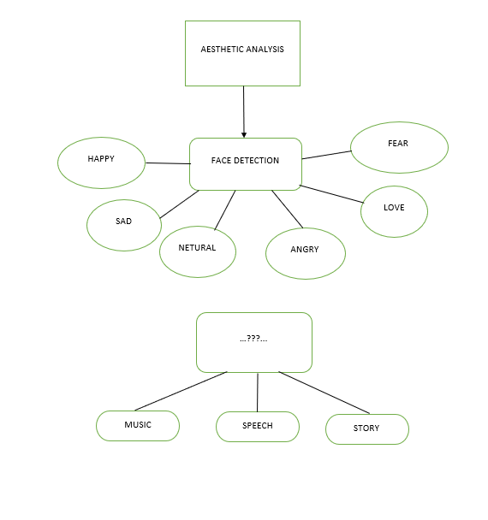
Workflow:

Slide 7
LITERATURE REVIEW:
As projects with emotional intelligence has already exits, now we have come up with new features such as live face detection , asking the user to choose their regional language and according to their emotions an audio or a speech or a book is referred to the user .
Since there is no such kind of features available in the existing model we have added extra comfort for the user .

Slide 8
OBJECTIVE:
Developed self awareness and self management of personal emotions.
Self-regulations is the ability to understand and manage your behavior and your reactions to feelings and things happening around you.
Motivation is the process that initiates, guides, and maintains goal-oriented behaviors.
Empathy the ability to understand and share the feelings of another.

Slide 9

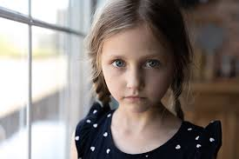


HAPPY
SAD

Slide 10
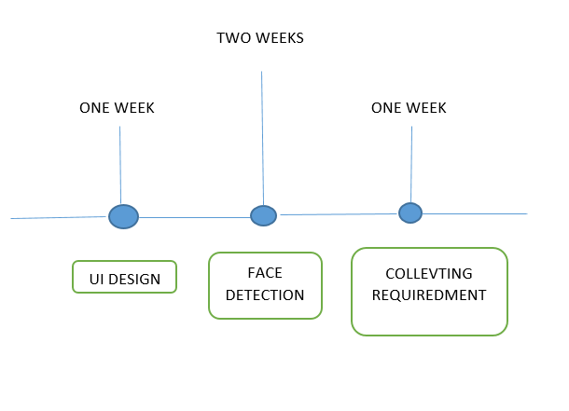
MODULES:
UI design
Face detection based on emotional
Collecting requirements
TIME LINE CHART:
UI design-8th APR
Face detection based on emotional-20th APR
Collecting requirements-5th MAY

Slide 11
THANK YOU

